Slide 1
Measuring Moisture
6.14.24 version 1.0

Slide 2
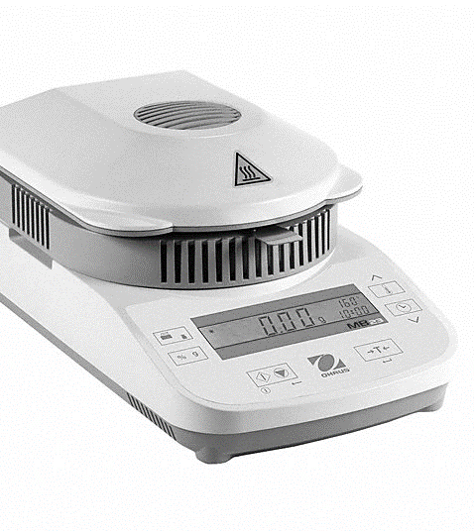
Assumptions and Prerequisite Skills
Yield is being measured (to be completed along with yield)
A batch is being actively discharged
Supplies Needed
Standard PPE
30g of batch mixture
Moisture Analyzer
1 copy of the Production Sheet

Slide 3
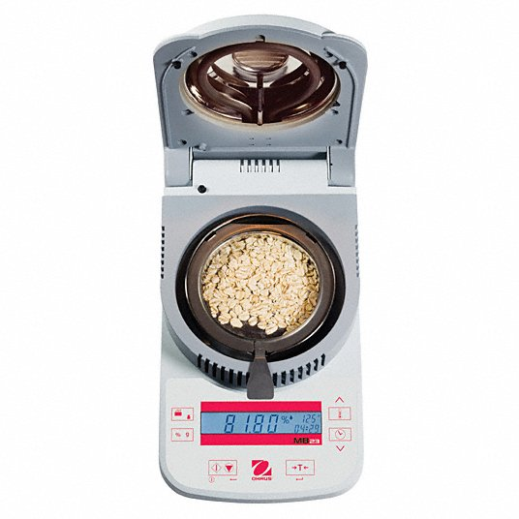
Turn on the moisture analyzer by pressing the button with the vertical line (Blue circle in Figure 1).
Figure 1

Slide 4
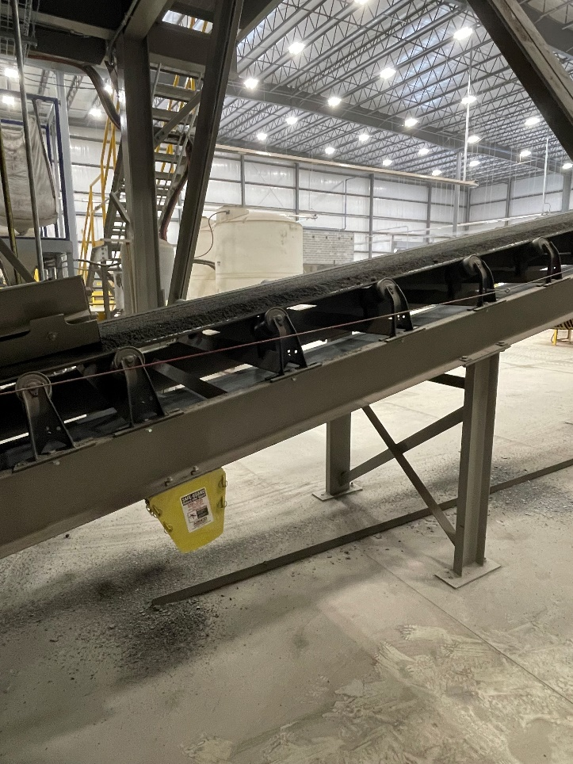
2. Go to the machine belt and take a handful of batch mix (Figure 2).
Figure 2

Slide 5
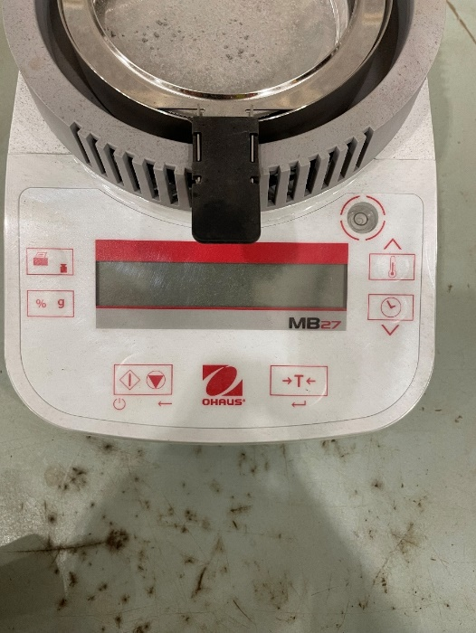

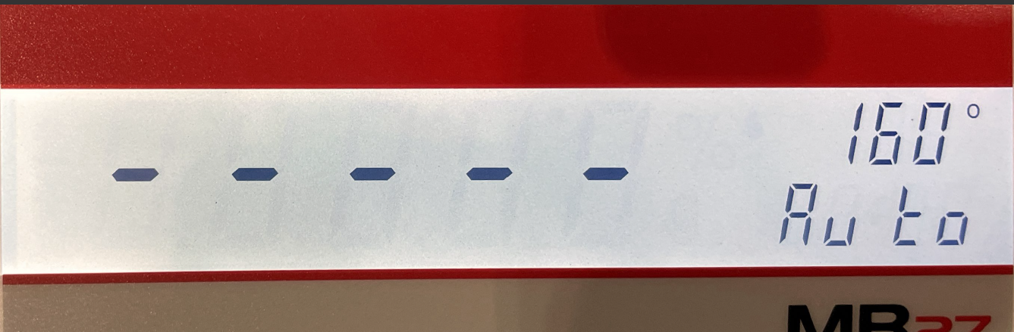
3. If the monitor has a measurement above or below 0 grams, press the T button to reset it. Horizontal lines will display and shortly after the display it will turn to 0. Do not continue to the next step until the screen displays 0 grams (Figure 3).
Figure 3

Slide 6
4. Open the Moisture Analyzer lid and put in a little at a time until you reach approximately 30 grams. Measurement values will show as material is being placed on the pan. Level mixture evenly on the pan.

Slide 7
5. Close the lid. The mass value may increase or decrease from this action. If so, open the lid back up and spread out the sample so the lid does not press on anything when closing.

Slide 8
6. Look for the Asterisk character in the top left corner of the display (Figure 4). This indicates that the mass shown has remained stagnant and will most likely not change unless the lid is opened back up.
Figure 4

Slide 9
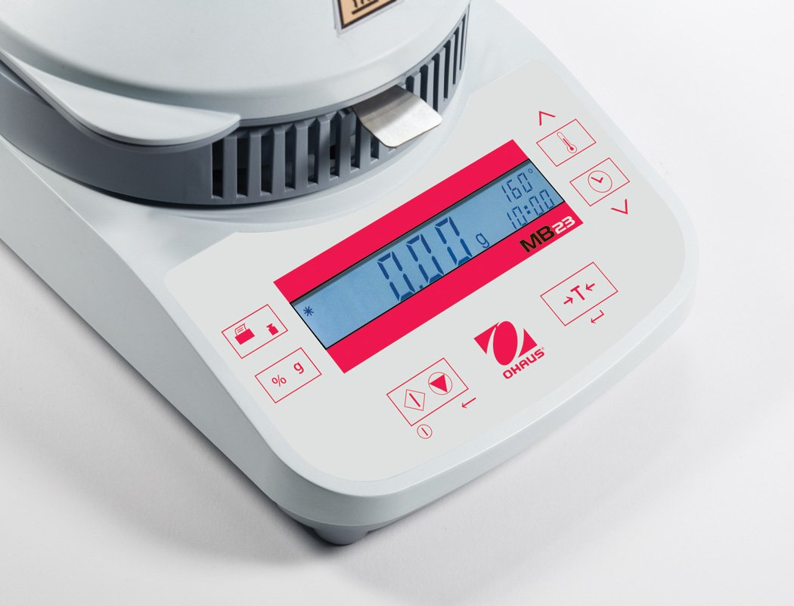
7. Press the button with the down arrow. This will start the burn off process (Blue circle in Figure 5).
Figure 5

Slide 10
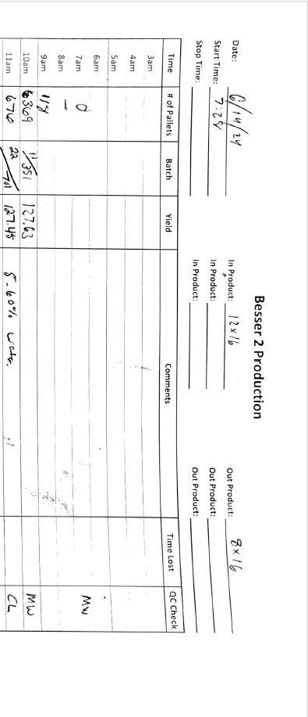
8. Once finished, the number on the display will start blinking. Do not touch the pan at this time as the content will be very hot. Examine the final value in the display, and record it in the comments of the “Production Sheet” (Figure 6).
Figure 6

Slide 11
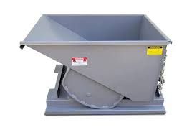
9. Once the aggregate has cooled off, dump the sample in the nearest waste hopper.

